Slide 1
OPIM 5272: Business Process Modeling
Hiring Process
Process Model Improvement Presentation
Team 11

Slide 2
Agenda
Introduction
Project Overview
Current state / Process “As is”
Future state - Enablers and Benefits
Entity Relationship Diagram
Data Tables
Data Creation & Implementation
Reports
Conclusion & Model Benefits
Q&A

Slide 3
Project Overview
Defined hiring process → success of a company
Resources, time, and money at stake
Collaborative process = Effective communication + planning

Slide 4
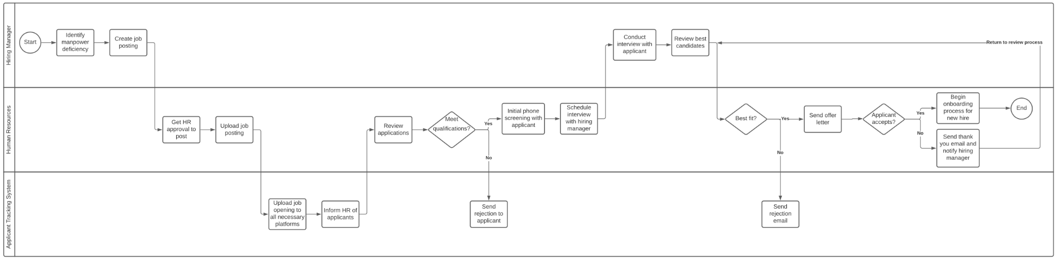
Current state / Process “As Is”

Slide 5
Current state / Process “As Is”

Slide 6
Future state - Enablers and Benefits
Enablers:
Workflow Design
Information System
Human Resources
Policies and Rules
Benefits:
Implementing a multi-round hiring process
Keeping track of Top 3 candidates for the final interview round
Adding notification of job offers and tracking the acceptance of job offers
Using the remaining Top 2 candidates as strategic retrofits if the 1st offer is rejected
Improving timing of sending rejection letters after the offer is accepted
Enabling streamlined talent searches at career fairs using standardized job profiles

Slide 7
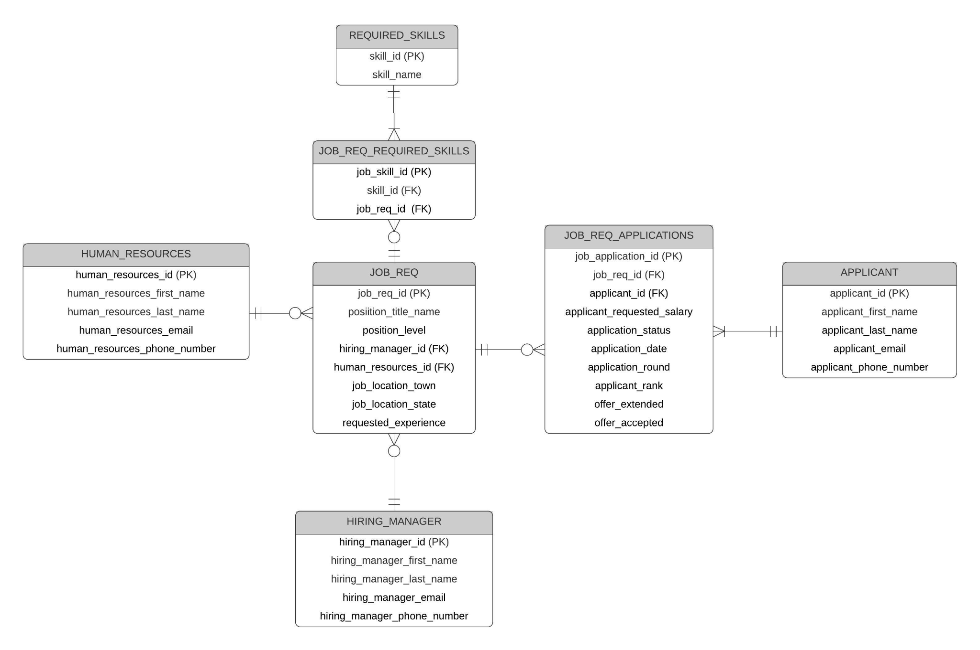
ERD

Slide 8
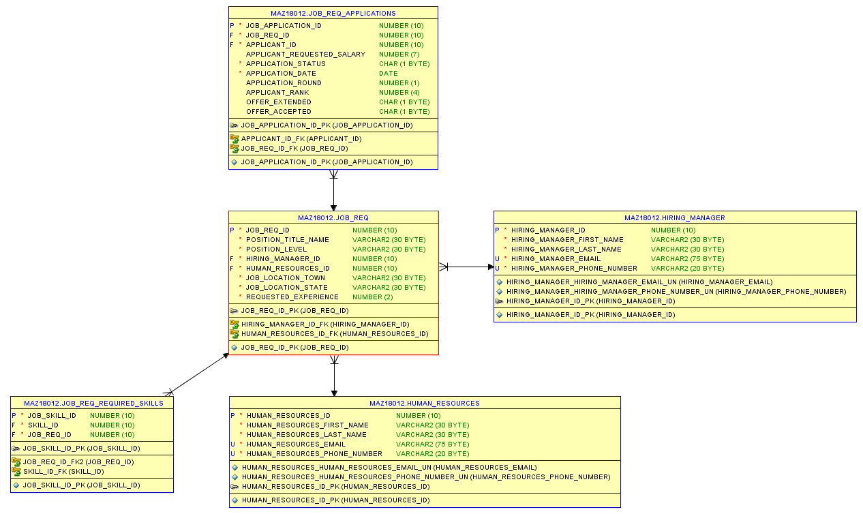
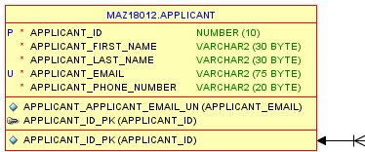
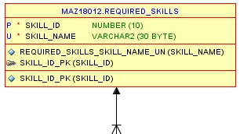
Data Tables

Slide 9
Data Creation & Implementation
Human Resources
Hiring Manager
Applicant
first.last@companyXYZ.com =CONCAT("860-", RANDBETWEEN(100,999),"-", RANDBETWEEN(1000,9999))

Slide 10
Data Creation & Implementation (Cont.)
Human Resources
Hiring Manager
Applicant
Job Req
=RANDBETWEEN()
=IFS(CELL<=3,"Associate",CELL<=6,"Intermediate",TRUE,"Senior")

Slide 11
Data Creation & Implementation (Cont.)
Human Resources
Hiring Manager
Applicant
Job Req
Job Req Applications
= RANDBETWEEN(40001, 40030) = CellAbove + RANDBETWEEN(0,4) = IFS(RAND()<=0.6,1,RAND()<=0.9,2,TRUE,3)

Slide 12
SQL Scripts Used to Update Requested Salary
------ Associate Requested Salary Update (40-55 for Associate, 65-95 for Intermediate, and 100-125 for senior)
UPDATE
MAZ18012.job_req_applications
SET
MAZ18012.job_req_applications.applicant_requested_salary
= trunc(DBMS_RANDOM.value(40,55), 0)*1000
WHERE job_req_id in (SELECT job_req_id
FROM MAZ18012.job_req
WHERE maz18012.job_req.position_level = 'Associate');
------ Set some of them back to null, 1/4th of them in this case.
UPDATE
MAZ18012.job_req_applications
SET
MAZ18012.job_req_applications.applicant_requested_salary
= null
WHERE (ROWID,0) IN (SELECT ROWID, MOD(ROWNUM,4)
FROM MAZ18012.job_req_applications);

Slide 13
Data Creation & Implementation (Cont.)
Human Resources
Hiring Manager
Applicant
Job Req
Job Req Applications
Required Skills
Job Req Required Skills
Manually create ID Manually select required skills per job req’s position title

Slide 14
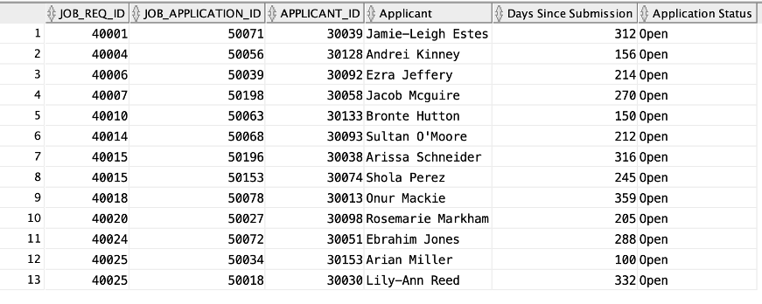
Report #1 - Stale Applications Left Open
Goal: Identify applications for job postings that were likely not provided job offers and have remained open.
Value: Reduce number of open applications for potential review by managers

Slide 15
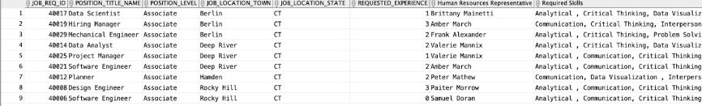
Report #2 - Career Fair Printout
Goal: Identify list of open job requisitions for associate level positions, locations, requested experience and skills, and applicable HR contact
Value: Report of open positions to be used at college career fairs to quickly identify and refer potential applicants to specific open requisitions

Slide 16
Conclusion & Model Benefits
Conclusion: old process is manual and labor intensive. New process is streamlined and optimized.
Benefits:
Reduced manpower waste
Value-add reports
Streamlined talent acquisition and retention
Identification of unappealing job requisitions

Slide 17
Thank you!
Q&A

